Slide 1
William Stallings
Computer Organization and Architecture
6th Edition
Chapter 11
Instruction Sets:
Addressing Modes
and Formats

Slide 2
Addressing Modes
Immediate
Direct
Indirect
Register
Register Indirect
Displacement (Indexed)
Stack
Notes:
2

Slide 3
Immediate Addressing
Operand is part of instruction
Operand = address field
e.g. ADD 5
  Add 5 to contents of accumulator
  5 is operand
No memory reference to fetch data
Fast
Limited range
Notes:
3

Slide 4
Immediate Addressing Diagram
Instruction
Opcode
Operand
Notes:
4

Slide 5
Direct Addressing
Address field contains address of operand
Effective address (EA) = address field (A)
e.g. ADD A
  Add contents of cell A to accumulator
  Look in memory at address A for operand
Single memory reference to access data
No additional calculations to work out effective address
Limited address space
Notes:
5

Slide 6
Direct Addressing Diagram
Instruction
Opcode
Address A
Memory
Operand
Notes:
6

Slide 7
Indirect Addressing (1)
Memory cell pointed to by address field contains the address of (pointer to) the operand
EA = (A)
  Look in A, find address (A) and look there for operand
e.g. ADD (A)
  Add contents of cell pointed to by contents of A to accumulator
Notes:
7

Slide 8
Indirect Addressing (2)
Large address space
2^{n} where n = word length
May be nested, multilevel, cascaded
  e.g. EA = (((A)))
    Draw the diagram yourself
Multiple memory accesses to find operand
Hence slower
Notes:
8

Slide 9
Indirect Addressing Diagram
Instruction
Opcode
Address A
Memory
Pointer to operand
Operand
Notes:
9

Slide 10
Register Addressing (1)
Operand is held in register named in address filed
EA = R
Limited number of registers
Very small address field needed
  Shorter instructions
  Faster instruction fetch
Notes:
10

Slide 11
Register Addressing (2)
No memory access
Very fast execution
Very limited address space
Multiple registers helps performance
  Requires good assembly programming or compiler writing
  N.B. C programming
    register int a;
c.f. Direct addressing
Notes:
11

Slide 12
Register Addressing Diagram
Instruction
Opcode
Register Address R
Registers
Operand
Notes:
12

Slide 13
Register Indirect Addressing
C.f. indirect addressing
EA = (R)
Operand is in memory cell pointed to by contents of register R
Large address space (2^{n})
One fewer memory access than indirect addressing
Notes:
13

Slide 14
Register Indirect Addressing Diagram
Instruction
Opcode
Register Address R
Memory
Registers
Pointer to Operand
Operand
Notes:
14

Slide 15
Displacement Addressing
EA = A + (R)
Address field hold two values
  A = base value
  R = register that holds displacement
  or vice versa
Notes:
15

Slide 16
Displacement Addressing Diagram
Instruction
Opcode
Register R
Address A
Memory
Registers
Pointer to Operand
+
Operand
Notes:
16

Slide 17
Relative Addressing
A version of displacement addressing
R = Program counter, PC
EA = A + (PC) ,sometimes used in branch instruction
i.e. get operand from A cells from current location pointed to by PC
c.f locality of reference & cache usage
Notes:
17

Slide 18
Base-Register Addressing
A holds displacement
R holds pointer to base address
R may be explicit or implicit
e.g. segment registers in 80x86
Notes:
18

Slide 19
Indexed Addressing
A = base
R = displacement
EA = A + R
Good for accessing arrays
  EA = A + R
  R++
Notes:
19

Slide 20
Combinations
Postindex
EA = (A) + (R)
Preindex
EA = (A+(R))
(Draw the diagrams)
Notes:
20

Slide 21
Stack Addressing
Operand is (implicitly) on top of stack
e.g.
  ADD Pop top two items from stack and add
Notes:
21

Slide 22
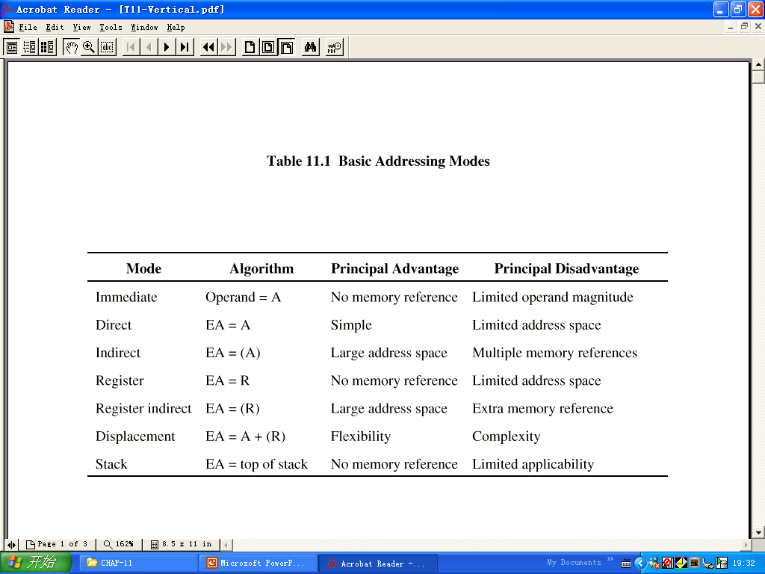

Slide 23
Pentium Addressing Modes
Virtual or effective address is offset into segment
  Starting address plus offset gives linear address
  This goes through page translation if paging enabled
12 addressing modes available
  Immediate
  Register operand
  Displacement
  Base
  Base with displacement
  Scaled index with displacement
  Base with index and displacement
  Base scaled index with displacement
  Relative

Slide 24
Pentium II Addressing Modes
Mode Algorithm
Immediate Operand=A
Register operand LA=R
Displacement LA=(SR)+A
Base LA=(SR)+(B)
Base with displacement
LA=(SR)+(B)+A

Slide 25
Base with displacement mode
(see page 391)
Used to access a field (member variable) of a record (struct variable)
The base register points to the beginning of the record, while the displacement is an offset to the field.

Slide 26
Pentium II Addressing Modes
Mode Algorithm
Scaled index with displacement
LA=(SR)+(I)XS+A
Base with index & displacement
LA=(SR)+(B)+(I)+A
Base with scaled index & displacement LA=
(SR)+(B)+(I)XS+A
Relative LA=(PC)+A

Slide 27
Scaled index with displacement mode
(see page 392)
Used for locating the element of an array
The Displacement points the beginning of array , the content of index register is subscript of array element & can be INC or DEC , scaled factor is type of data

Slide 28
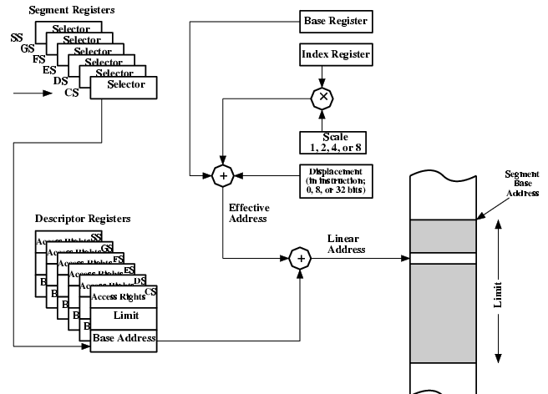
Pentium Addressing Mode Calculation

Slide 29
PowerPC Addressing Modes
Load/store architecture
  Indirect (base with displacement)
    Instruction includes 16 bit displacement to be added to base register (may be GP register)
    Can replace base register content with new address
  Indirect indexed (base with index)
    Instruction references base register and index register (both may be GP)
    EA is sum of contents

Slide 30
Branch address
  Absolute (immediate is target)
  Relative (PC)+immediate
  Indirect (a specific register)
Arithmetic
  Operands in registers (register) or part of instruction (immediate)
  Floating point is register only

Slide 31
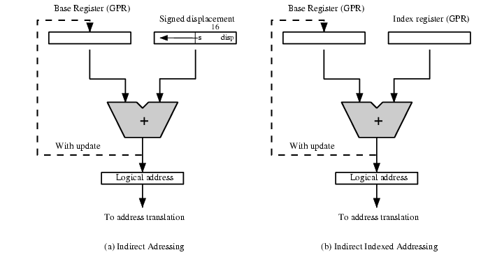
PowerPC Memory Operand
Addressing Modes

Slide 32
§11.3 Instruction Formats
Layout of bits in an instruction
Includes opcode
Includes (implicit or explicit) operand(s)
Usually more than one instruction format in an instruction set

Slide 33
Instruction Length
Affected by and affects:
  Memory size
  Memory organization
  Bus structure
  CPU complexity
  CPU speed
Trade off between powerful instruction repertoire and saving space

Slide 34
Allocation of Bits
Number of addressing modes
Number of operands
Register versus memory
Number of register sets
Address range
Address granularity(scale factor –1,2,4 or 8 bytes)

Slide 35
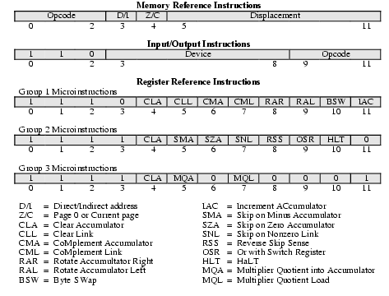
PDP-8 Instruction Format

Slide 36
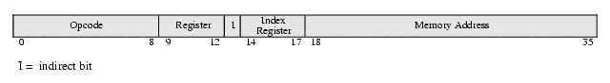
PDP-10 Instruction Format

Slide 37
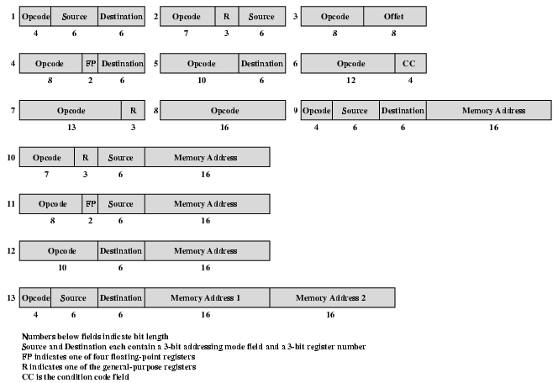
PDP-11 Instruction Format

Slide 38
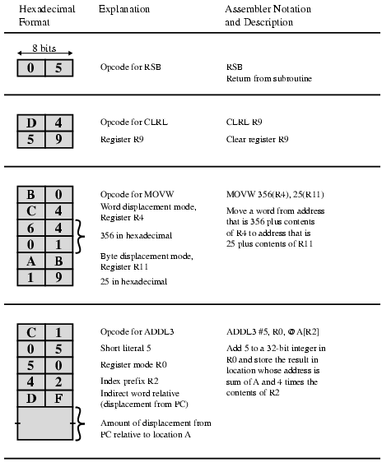
VAX Instruction Examples

Slide 39
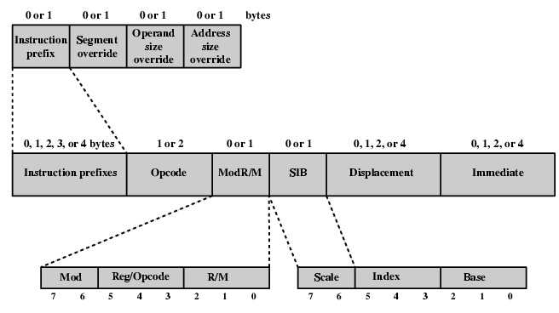
Pentium Instruction Format
(variable length instruction -complex)

Slide 40
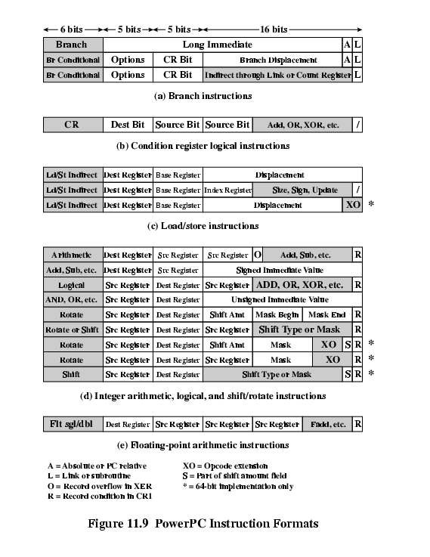
PowerPC Instruction Formats
(fixed length instruction - simple) (1)

Slide 41
PowerPC Instruction Formats (2)

Slide 42
Foreground Reading
Stallings chapter 11
Intel and PowerPC Web sites

